Slide 1
CLUSTERING
Affinity propagation
Mean shift
Spectral Clustering
DBSCAN
OPTICS
BIRCH

Slide 2
Affinity Propagation
Affinity propagation is an clustering algorithm.
Its based on the concept of message passing between the data points.
Clustering algorithm’s such as K-means or K-medoids, affinity propagation doesn’t
require to number of cluster’s to determined or estimated before running the
algorithm.
Affinity propagation is useful when you don’t know the number of clusters in advance
and can automatically discover the optimal number of clusters based on the data.
Its Instead takes as input measures of similarity between pairs of data points and
simultaneously considers all data points as potential exemplars.
Similar to K-medoids, affinity propagation finds Exemplars, members of the input set
that are representative of clusters

Slide 3
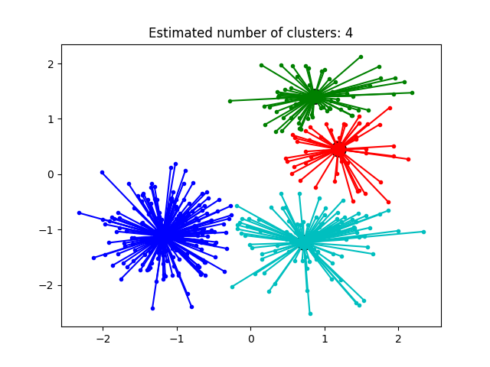

Slide 4
Similarities between data points, representing how well-suited a point is to be another one’s exemplar. If there’s no similarity between two points, as in they cannot belong to the same cluster, this similarity can be omitted or set to -Infinity depending on implementation.
Preferences, representing each data point’s suitability to be an exemplar. We may have some a priori information which points could be favored for this role, and so we can represent it through preferences.

Slide 5
MEAN SHIFT ALGORITHM
Mean-shift algorithm basically assigns the datapoints to the clusters iteratively by shifting points towards the highest density of datapoints in cluster centroid.
The difference between K-Means algorithm and Mean-Shift is that later one does not need to specify the number of clusters in advance because the number of clusters will be determined by the algorithm

Slide 6
WORKING OF MEAN SHIFT ALGORITHM
Step 1 − First, start with the data points assigned to a cluster of their own.
Step 2 − Next, this algorithm will compute the centroids.
Step 3 − In this step, location of new centroids will be updated.
Step 4 − Now, the process will be iterated and moved to the higher density region.
Step 5 − At last, it will be stopped once the centroids reach at position from where it cannot move further.

Slide 7
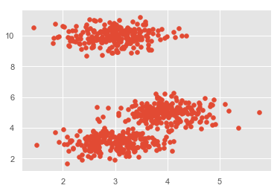
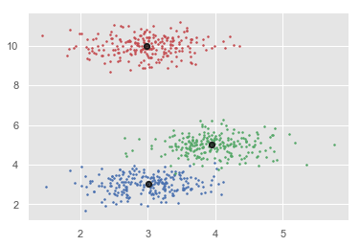
Mean Shift Algorithm

Slide 8
Spectral clustering
Spectral Clustering is known as segmentation based object categorization
Spectral clustering is a variant of the clustering that uses the connectivity between the datapoints to from the clustering.
Its based on spectral graph theory and is particularly effective for partitioning data into clusters when the underlying structure is not necessarily spherical or well separated

Slide 9
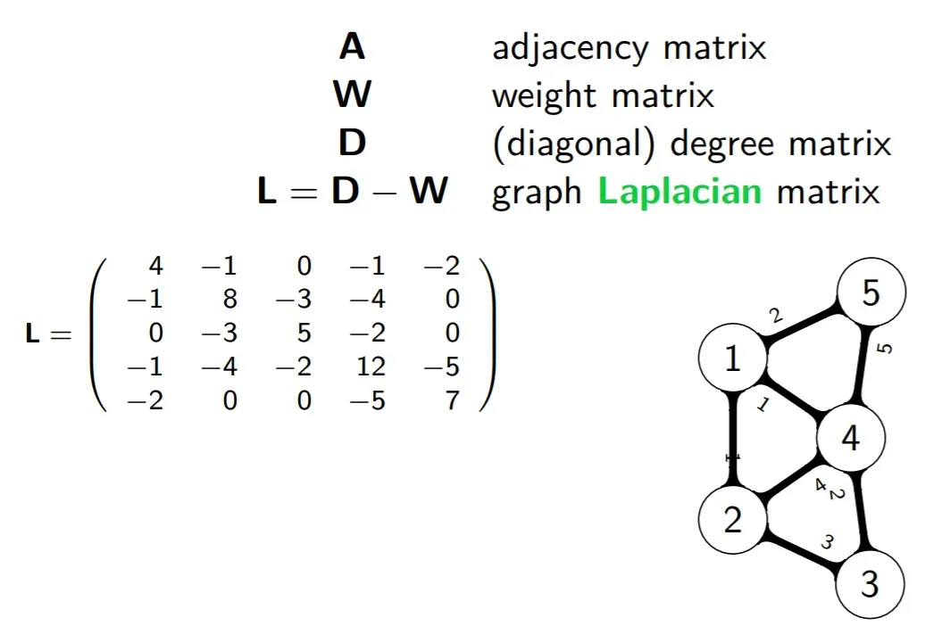
Spctral Clustering Algrithm
Adjacency matrix W
Degree matrix D
Matrix representation
Laplacian matrix L

Slide 10
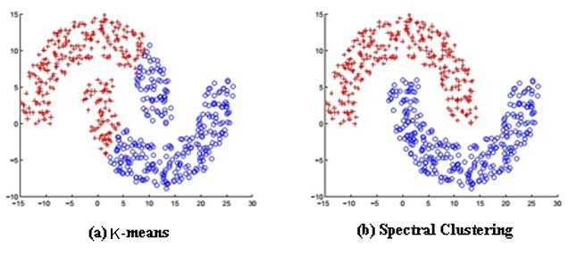
Spectral clustering

Slide 11
DBSCAN ALGORITHM
Density Based Spatial Clustering Of Applications With Noise
DBSCAN is a density based clustering algorithm that groups data points into clusters based on their density in a feature space
DBSCAN is a clustering algorithm that defines clusters as continuous regions of high density and works well if all the clusters are dense enough and well separated by low-density regions.

Slide 12
part of DBSCAN clustering
eps (ε): A distance measure that will be used to locate the points in the neighborhood of any point.
minPts: The minimum number of points (a threshold) clustered together for a region to be considered dense
Core — This is a point that has at least m points within distance n from itself.
Border — This is a point that has at least one Core point at a distance n
Noise — This is a point that is neither a Core nor a Border. And it has less than m points within distance n from itself.

Slide 13
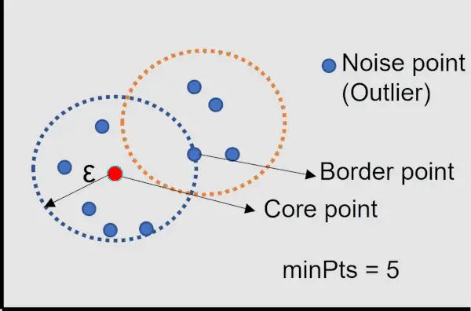
Part of DBSCAN clustering :
Epsilon
Min points
Core points
Border points
Noise points

Slide 14
OPTICS ALGORITHM
OPTICS(Ordering Points To Identify the Clustering Structure) is a density based clustering algorithm similar to densities and shapes.
Optics calculates a reachability point distance for each data point which represents how close or similar it is to its neighboring points.
For each data point the algorithm also DBSCAN but it can extract clusters of varying computes a core distance. The core distance is the minimum reachability distance of a point from any of its neighbors.
It measures how densly packed a cluster is around a particular point. points with lower core distance are more likely to be at the center of a cluster.

Slide 15
Parts of OPTICS Algorithm
Epsilon
Minpoints
Core points
Border points
Noise points
Core distance
Reachability distance
Core distance:
The minimum epsilon to make a distinct point a core point,given a finite MinPts parameter.
Reachability distance:
The reachability distance of an object p with respect to another object O is the smallest distance from O if O is a core object.it also cannot be smaller than the core distance of O

Slide 16
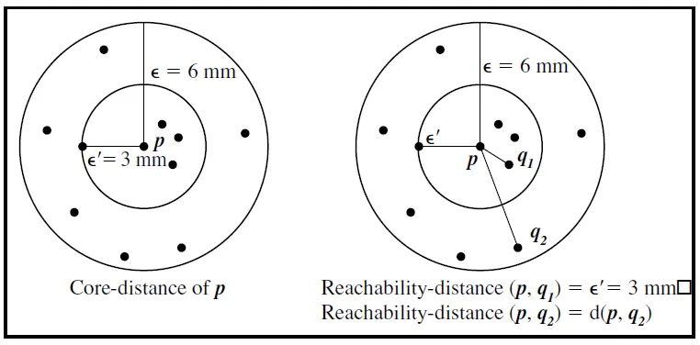
OPTICS ALGORITHM

Slide 17
BIRCH CLUSTERING
Balanced iterative reducing and clustering using hierarchies.
It is a scalable clustering method.
Designed for very large datasets.
Only one scan of data is necessary.
It is based on the notation of Clustering Features a CF Tree.
CF Tree is a height balanced tree that stores the clustering features for a hierarchical clustering.
Cluster of data points is represented by a triple of numbers (N,LS,SS)
N=Number of items in the sub cluster.
LS=Linear sum of the points.
SS=sum of the squared of the points.

Slide 18
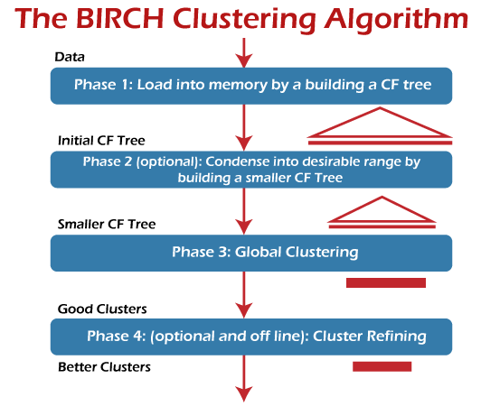

Slide 19
